Slide 1
HOP-HMM
Classification of DNA Sequences
David Taub

Slide 2
Outlines
Research Goal
Gene Regulation
TFBS & PWMs
HMM
HOP-HMM
Baum-Welch
Evaluation
Human DNA

Slide 3
Classification of DNA Sequences
TTACAGAGATAACGAGCTACTTTATTAAGACATTACGTTACAGAGATAAGACATCTTTATGACATACATTACGTTACATAAGACATCTGTGTACGTTACTTTATTAATACGTTACGT
Enhancer
Promoter
Gene
DNA
TF
TF
Transcription Factor Binding Sites

Slide 4
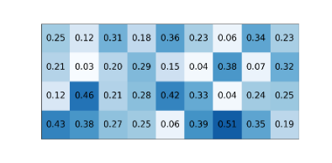
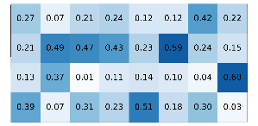
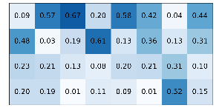








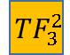

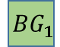
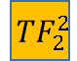

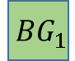

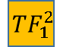









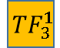



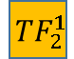
HMM to HOP-HMM
HOP-HMM
$$0.5$$
$$0.05$$
$$0.0$$
$$0.05$$
$$0.1$$
$$0.8$$
$$BG_{1}$$
$$TF_{1}^{1}$$
$$TF_{2}^{1}$$
$$TF_{3}^{1}$$
HMM
$$1$$
$$G$$
$$T$$
$$A$$
$$C$$
$$BG_{1}$$
$$BG_{2}$$
$$0.5$$
$$G$$
$$T$$
$$0.8$$
$$BG_{2}$$
$$TF_{1}^{2}$$
$$TF_{2}^{2}$$
$$TF_{3}^{2}$$
$$G$$
$$T$$
$$A$$
$$C$$
$$A$$
$$C$$
$$0.1$$
$$1$$
$$G$$
$$T$$
$$A$$
$$C$$

Slide 5
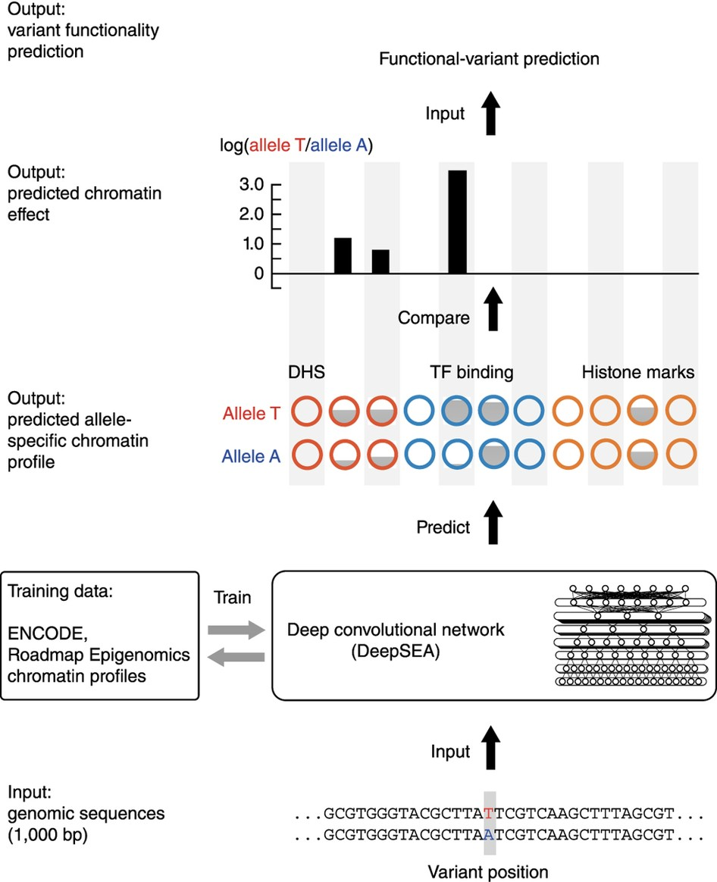
DeepSEA
Zhou & Troyanskaya (2015)

Slide 6
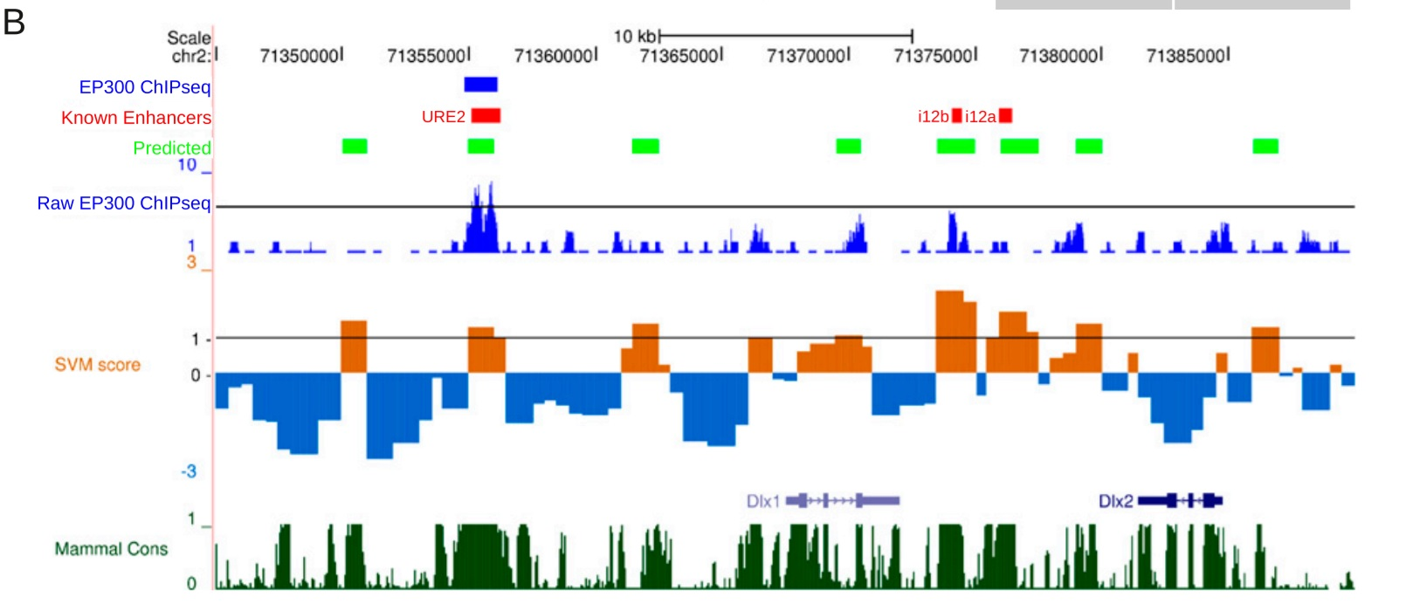
kmer-SVM
Lee et al. 2011

Slide 7
Outlines
Research Goal
Gene Regulation
TFBS & PWMs
HMM
HOP-HMM
Baum-Welch
Evaluation
Human DNA

Slide 8
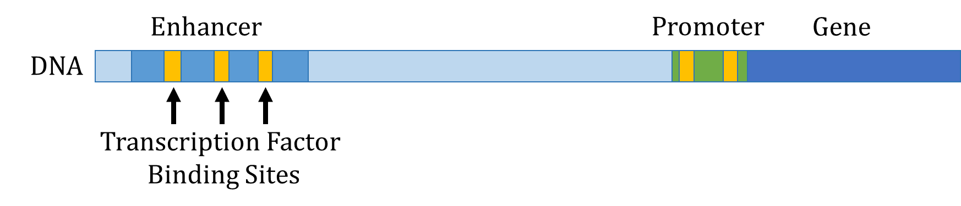

Slide 9
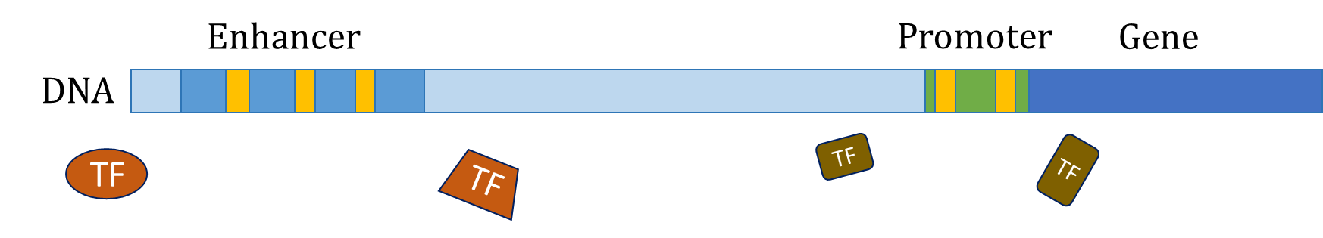

Slide 10
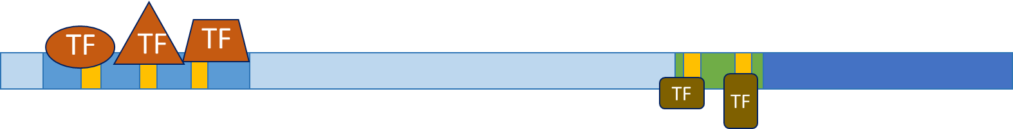

Slide 11


Slide 12
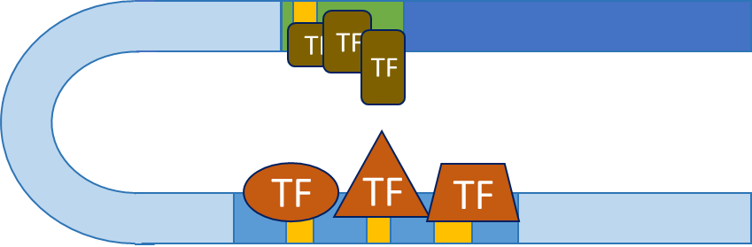

Slide 13
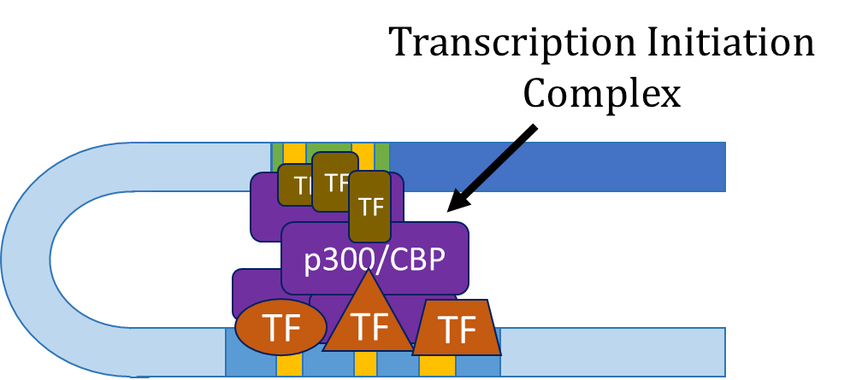

Slide 14
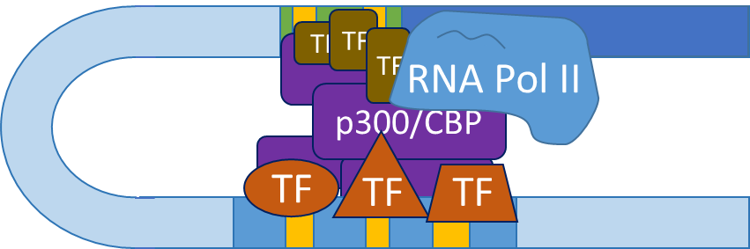

Slide 15
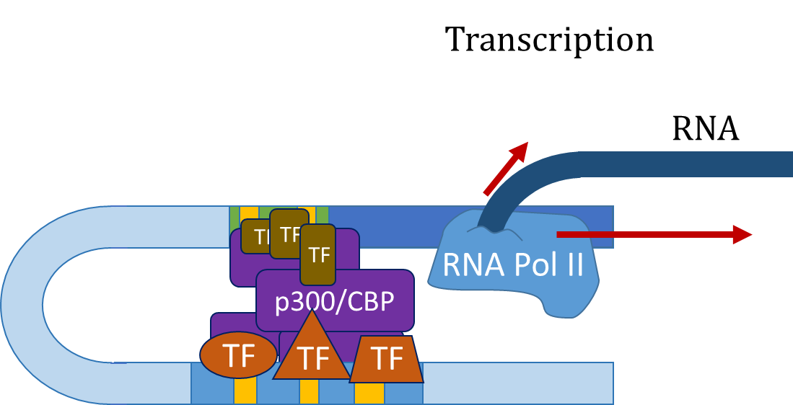

Slide 16
Outlines
Research Goal
Gene Regulation
TFBS & PWMs
HMM
HOP-HMM
Baum-Welch
Evaluation
Human DNA

Slide 17
TFBS & PWMs
Enhancer
DNA
TF
TF
Transcription Factor Binding Sites

Slide 18
TFBS & PWMs
…CGAGCTACTTTATTAAGACATTACGTTACAGAGATAA…
Enhancer
DNA
TF
TF
Transcription Factor Binding Sites

Slide 19
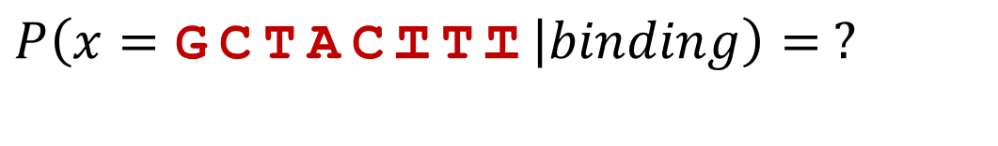
TFBS & PWMs
…CGAGCTACTTTATTAAGACATTACGTTACAGAGATAA…
$$P\left(x=\text{GCTACTTT} | binding\right)= ?$$

Slide 20
TFBS & PWMs
…CGAGCTACTTTATTAAGACATTACGTTACAGAGATAA…
$$P\left(x=\text{GCTACTTT} | binding\right)= ?$$
other binding sites
(ChIP-seq)
ACTACTTT
CCGACTTT
GTAACTCA
GGGAGGCT
GTGGCGCT
GGAACGTG
GCTACTTT

Slide 21
TFBS & PWMs
…CGAGCTACTTTATTAAGACATTACGTTACAGAGATAA…
$$P\left(x=\text{GCTACTTT} | binding\right)= ?$$
other binding sites
(ChIP-seq)
A:10260001
C:13306030
G:52011301
T:02200445
ACTACTTT
CCGACTTT
GTAACTCA
GGGAGGCT
GTGGCGCT
GGAACGTG
GCTACTTT

Slide 22
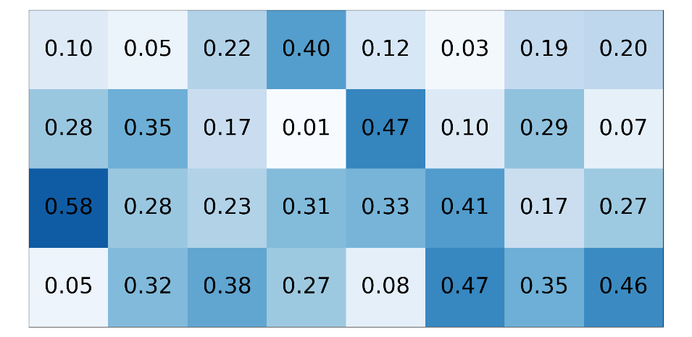
TFBS & PWMs
…CGAGCTACTTTATTAAGACATTACGTTACAGAGATAA…
$$P\left(x=\text{GCTACTTT} | binding\right)= ?$$
other binding sites
(ChIP-seq)
PWM (W)
A:10260001
C:13306030
G:52011301
T:02200445
ACTACTTT
CCGACTTT
GTAACTCA
GGGAGGCT
GTGGCGCT
GGAACGTG
GCTACTTT

Slide 23
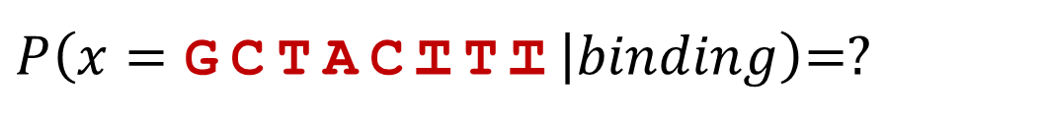
TFBS & PWMs
…CGAGCTACTTTATTAAGACATTACGTTACAGAGATAA…
$P\left(x=\text{GCTACTTT} | binding\right)$=?
PWM (W)

Slide 24
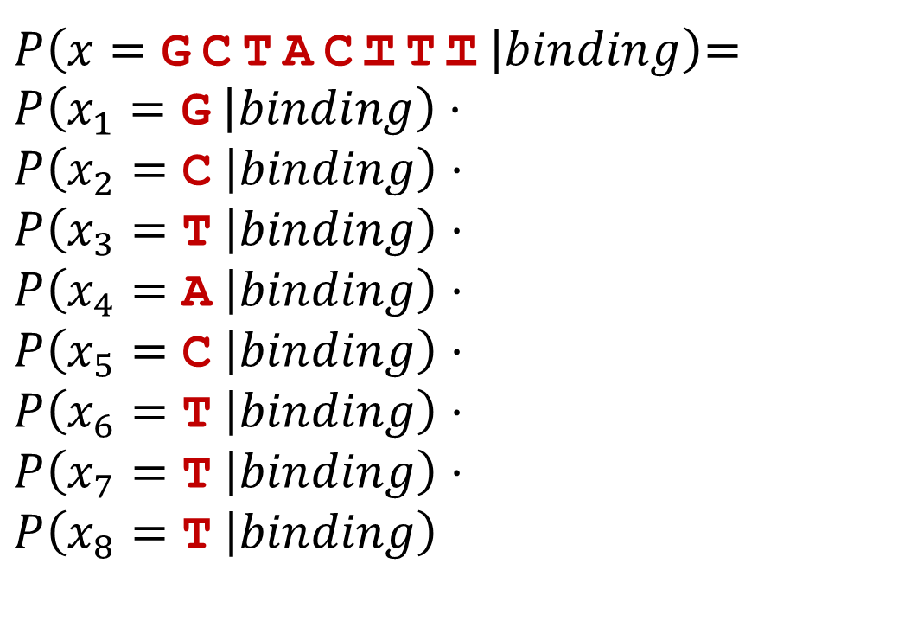
TFBS & PWMs
…CGAGCTACTTTATTAAGACATTACGTTACAGAGATAA…
$P\left(x=\text{GCTACTTT} | binding\right)$=
$$P\left(x_{1}=\text{G} | binding\right)⋅$$
$$P\left(x_{2}=\text{C} | binding\right)⋅$$
$$P\left(x_{3}=\text{T} | binding\right)⋅$$
$$P\left(x_{4}=\text{A} | binding\right)⋅$$
$$P\left(x_{5}=\text{C} | binding\right)⋅$$
$$P\left(x_{6}=\text{T} | binding\right)⋅$$
$$P\left(x_{7}=\text{T} | binding\right)⋅$$
$$P\left(x_{8}=\text{T} | binding\right)$$
positional independence assumption
PWM (W)

Slide 25
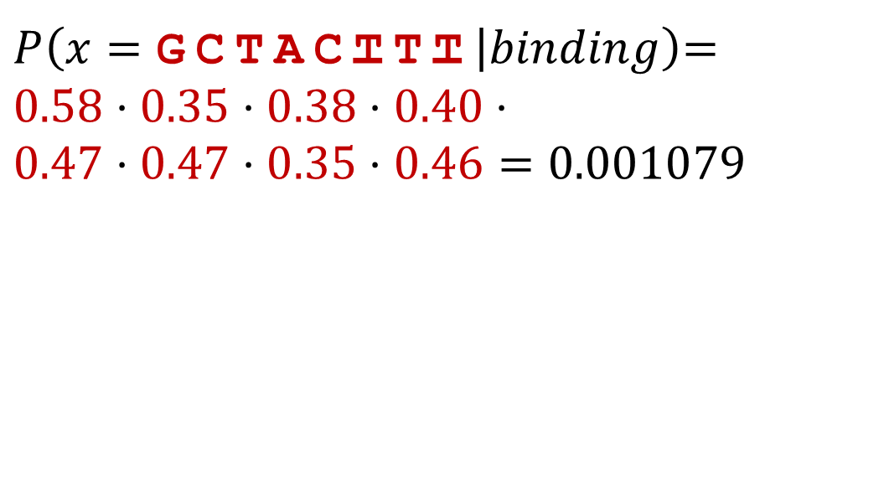
TFBS & PWMs
…CGAGCTACTTTATTAAGACATTACGTTACAGAGATAA…
$P\left(x=\text{GCTACTTT} | binding\right)$=
$$0.58⋅0.35⋅0.38⋅0.40⋅$$
$$0.47⋅0.47⋅0.35⋅0.46=\text{0}\text{.}\text{001079}$$
PWM (W)

Slide 26
TFBS & PWMs
…CGAGCTACTTTATTAAGACATTACGTTACAGAGATAA…
$P\left(x=\text{GCTACTTT} | binding\right)$=
$$0.58⋅0.35⋅0.38⋅0.40⋅$$
$$0.47⋅0.47⋅0.35⋅0.46=\text{0}\text{.}\text{001079}$$
PWM (W)
Small number,
log likelihood is more convenient

Slide 27
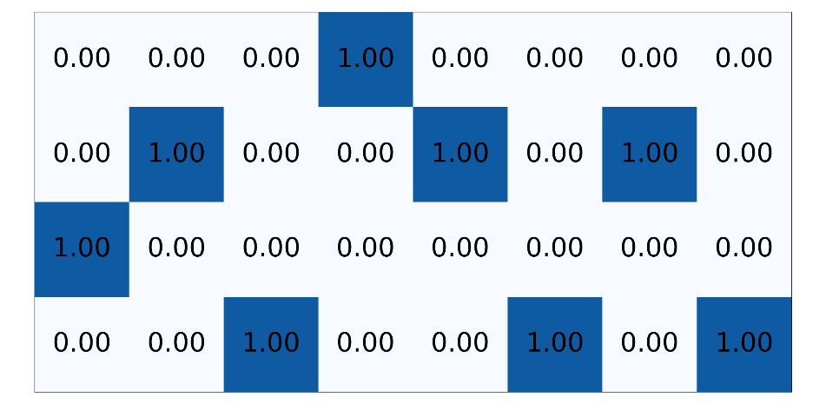

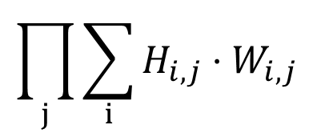
Using PWMs
…CGACTCCGTATA…
One-hot encoding (H)
PWM (W)
$$\prod_{j}{\sum_{i}{H_{i,j}}⋅W_{i,j}}$$
*

Slide 28
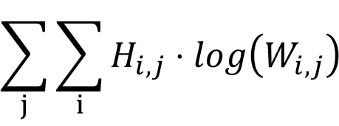
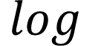
Using PWMs
…CGACTCCGTATA…
One-hot encoding (H)
PWM (W)
$$\sum_{j}{\sum_{i}{H_{i,j}}⋅log\left(W_{i,j}\right) }$$
*
$$log$$

Slide 29
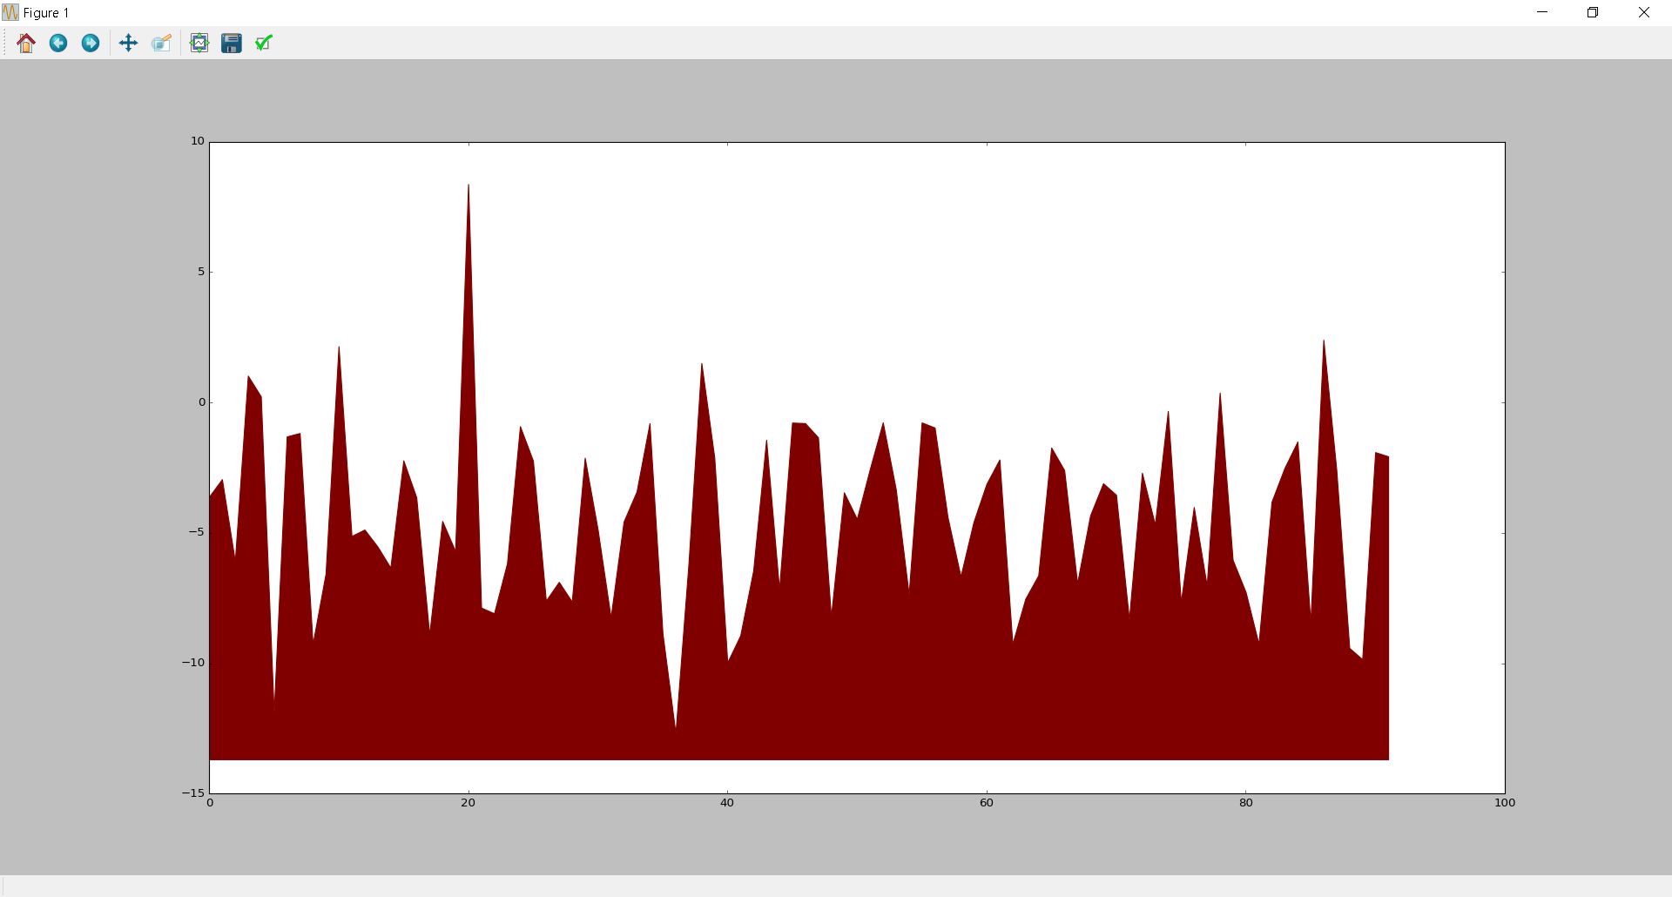
Using PWMs
…CGACTCCGTATA…
One-hot encoding (H)
PWM (W)
$$\sum_{j}{\sum_{i}{H_{i,j}}⋅log\left(W_{i,j}\right) }$$
*
$$log$$
Log likelihood of TF binding
Location in sequence

Slide 30
Outlines
Research Goal
Gene Regulation
TFBS & PWMs
HMM
HOP-HMM
Baum-Welch
Evaluation
Human DNA

Slide 31
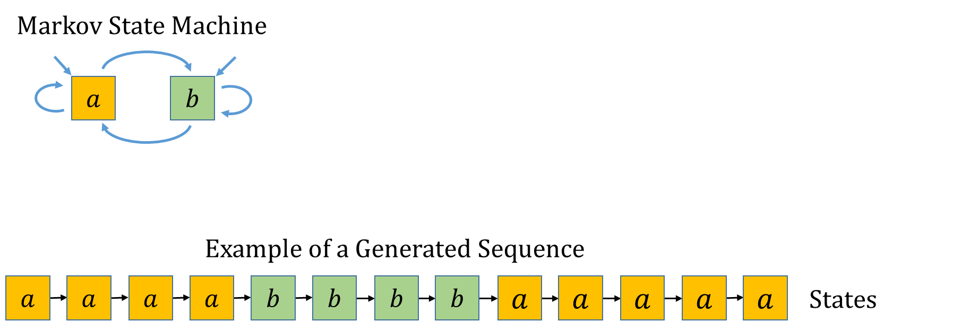
Hidden Markov Model

Slide 32
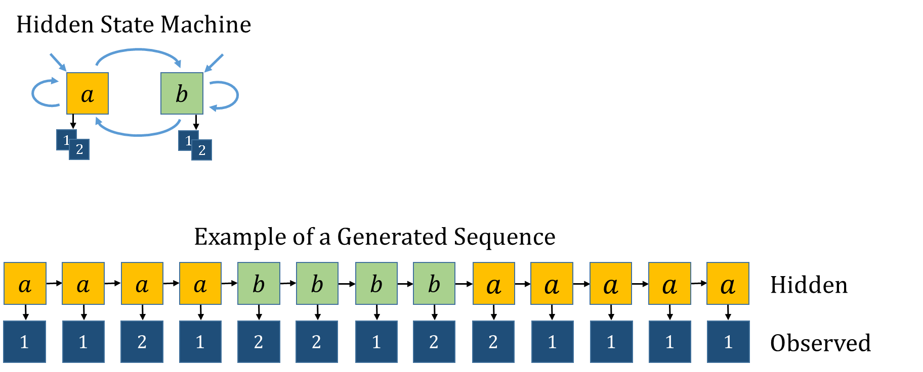
Hidden Markov Model

Slide 33
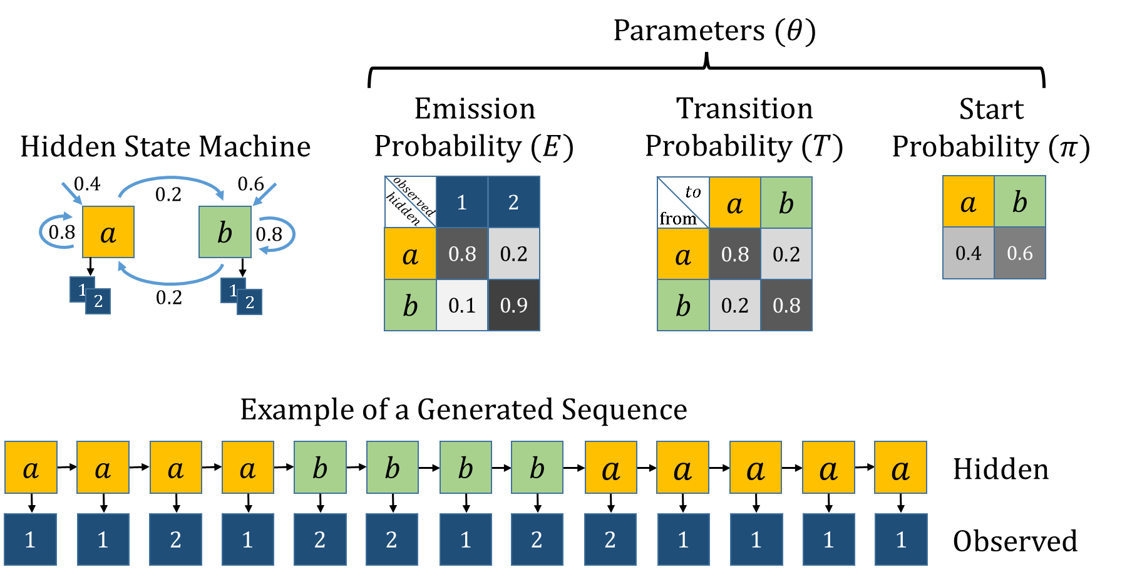
Hidden Markov Model

Slide 34
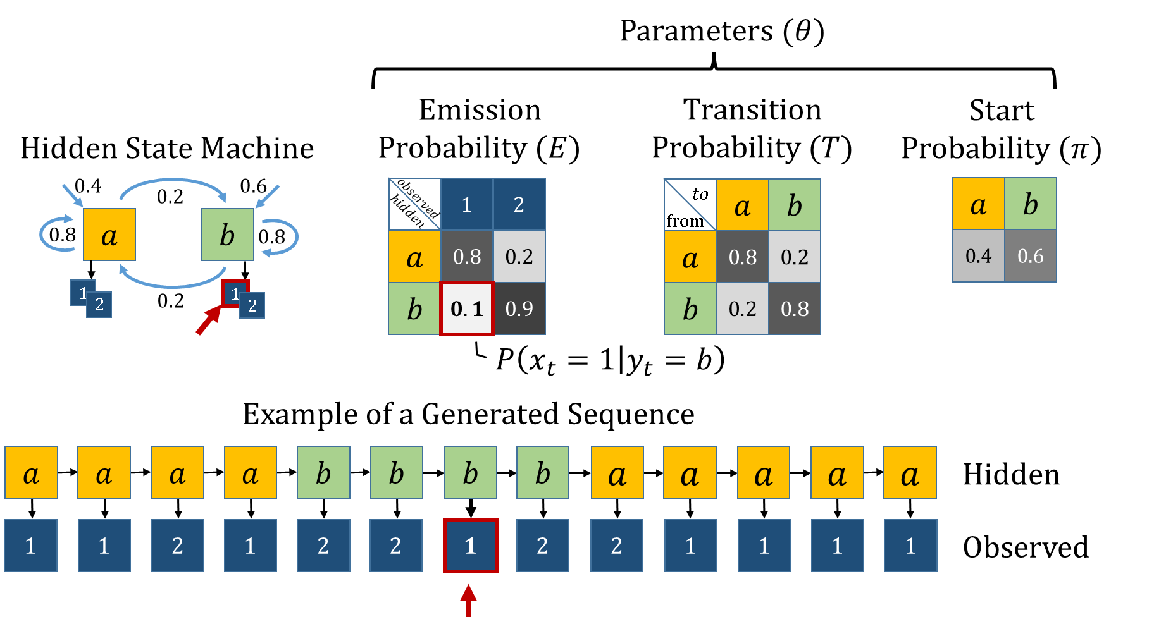
Hidden Markov Model

Slide 35
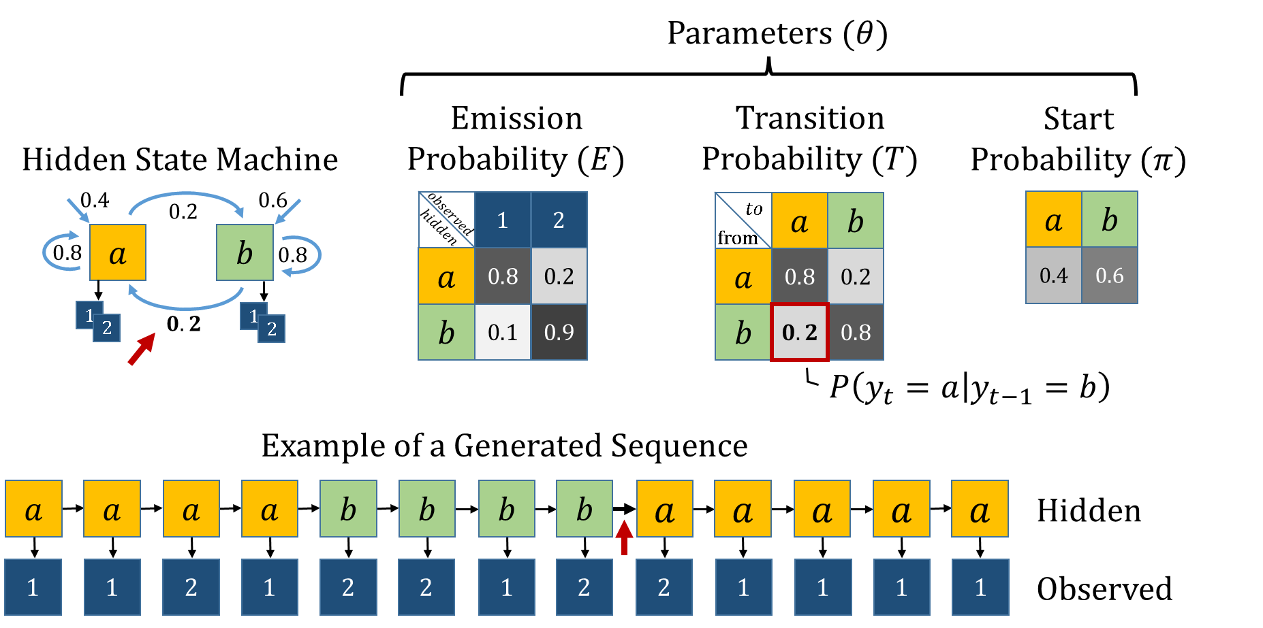
Hidden Markov Model

Slide 36
Outlines
Research Goal
Gene Regulation
TFBS & PWMs
HMM
HOP-HMM
Baum-Welch
Evaluation
Human DNA

Slide 37
HMM to HOP-HMM
HOP-HMM
$$0.5$$
$$0.05$$
$$0.0$$
$$0.05$$
$$0.1$$
$$0.8$$
$$BG_{1}$$
$$TF_{1}^{1}$$
$$TF_{2}^{1}$$
$$TF_{3}^{1}$$
HMM
$$1$$
$$G$$
$$T$$
$$A$$
$$C$$
$$BG_{1}$$
$$BG_{2}$$
$$0.5$$
$$G$$
$$T$$
$$0.8$$
$$BG_{2}$$
$$TF_{1}^{2}$$
$$TF_{2}^{2}$$
$$TF_{3}^{2}$$
$$G$$
$$T$$
$$A$$
$$C$$
$$A$$
$$C$$
$$0.1$$
$$1$$
$$G$$
$$T$$
$$A$$
$$C$$

Slide 38
Enhancer
DNA
TF
TF

Slide 39
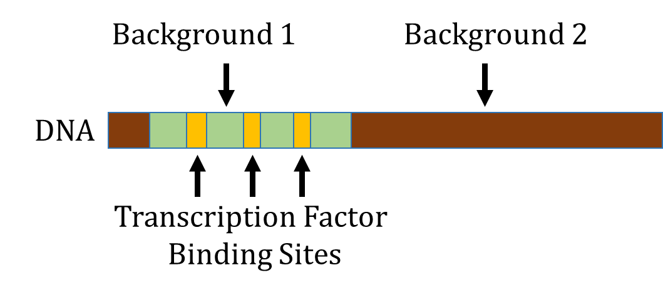

Slide 40
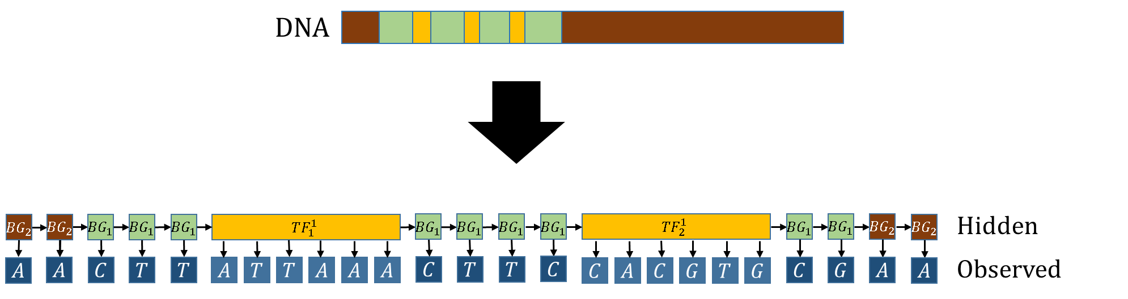
HOP-HMM matches the structure of the enhancer

Slide 42
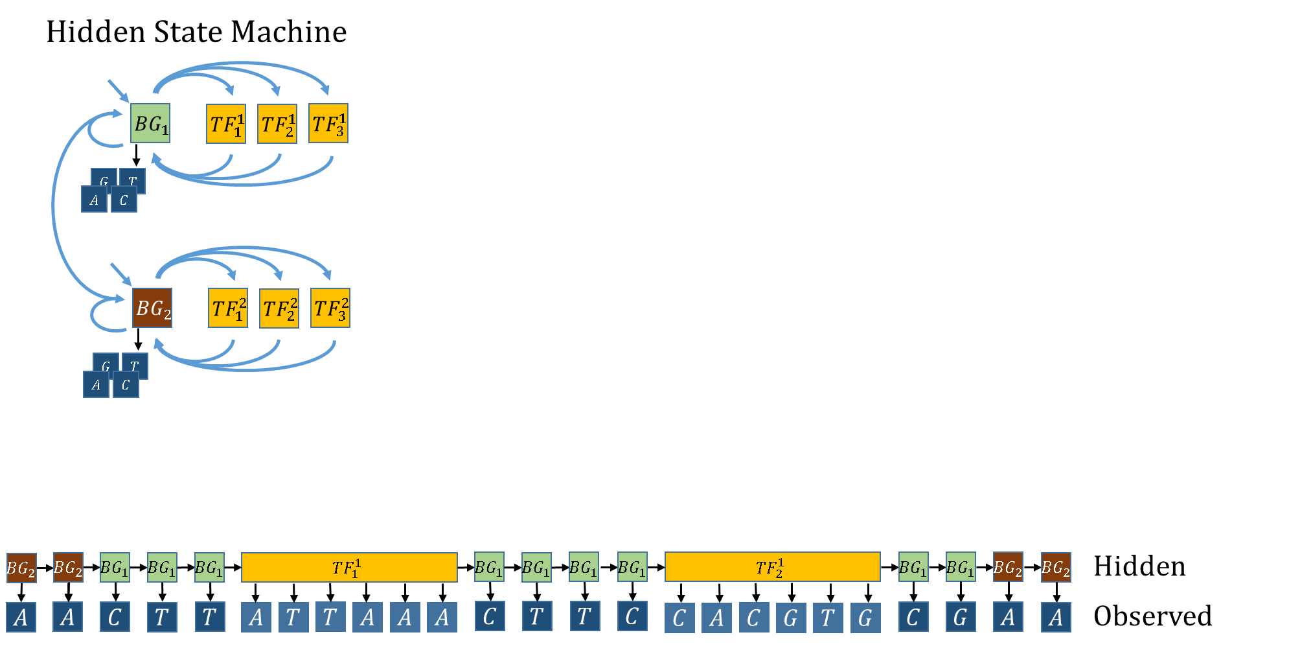

Slide 43
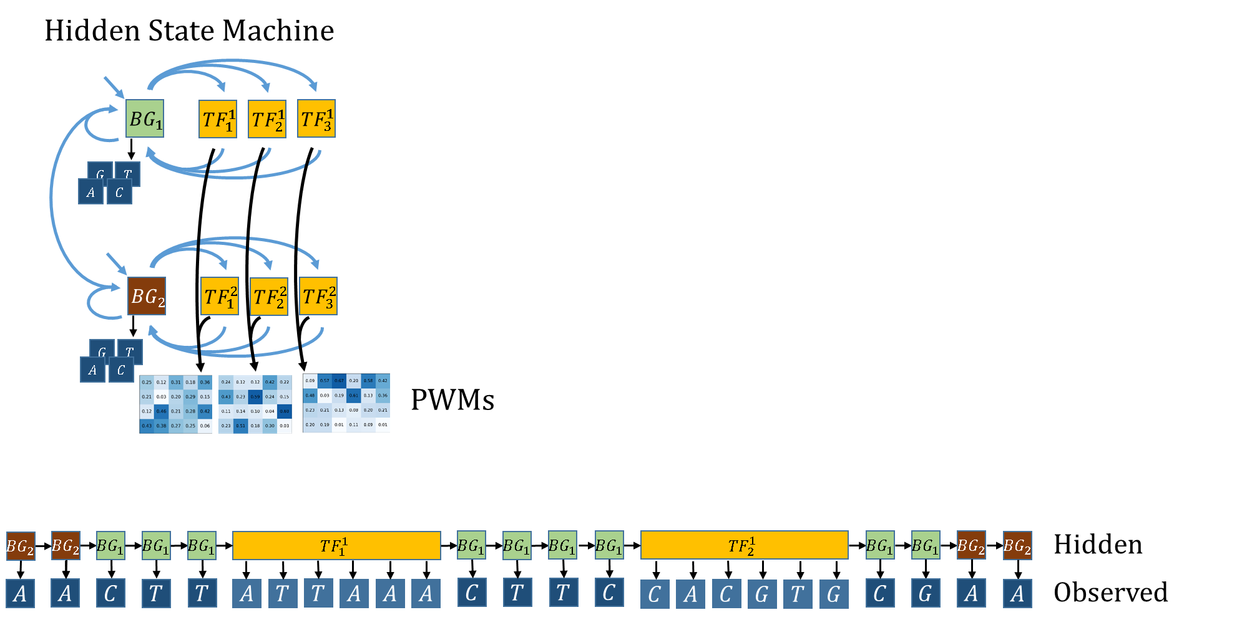

Slide 44
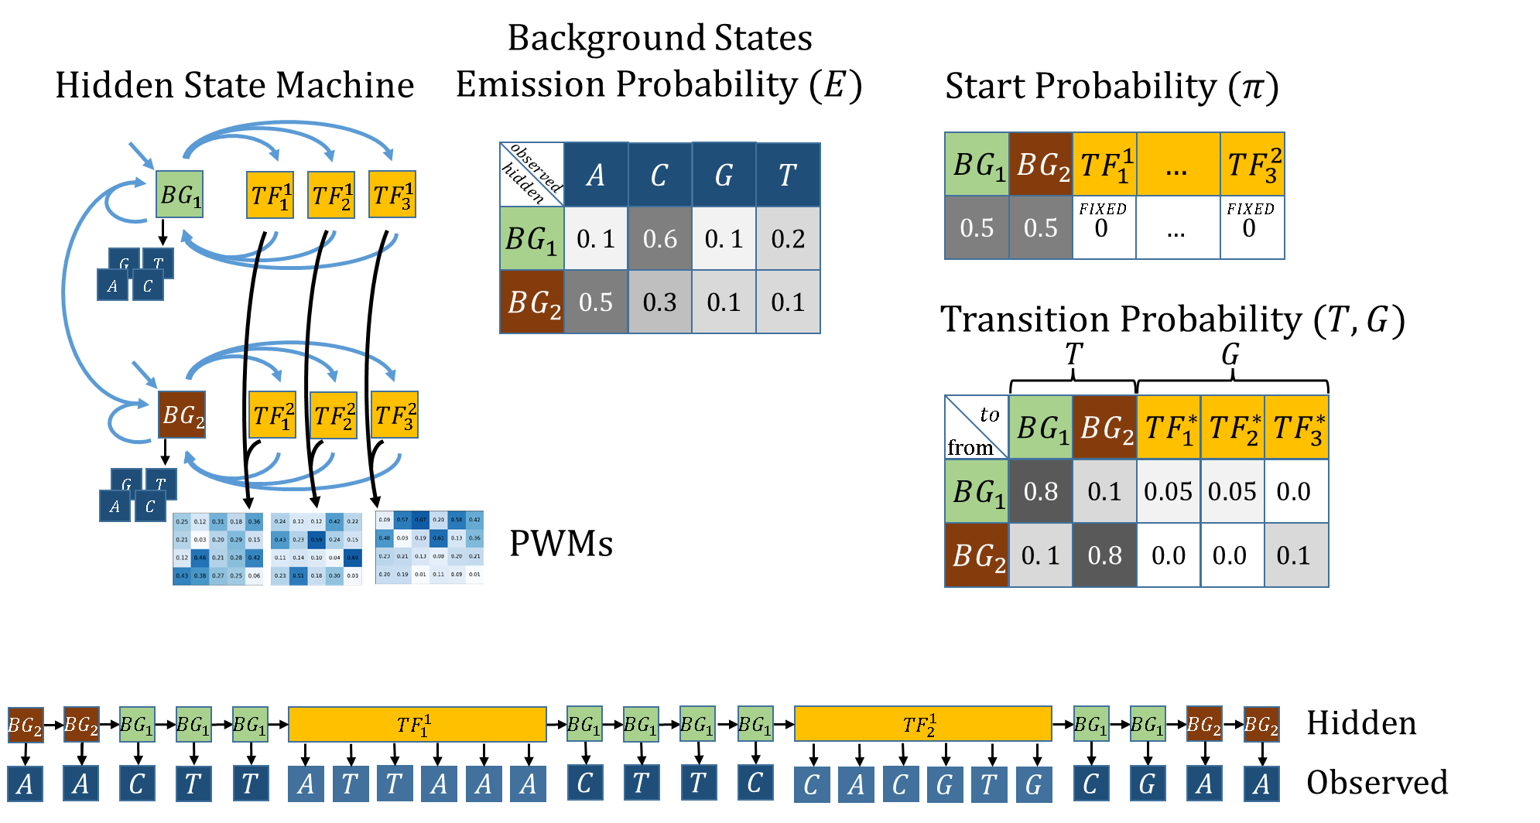

Slide 45


Slide 46
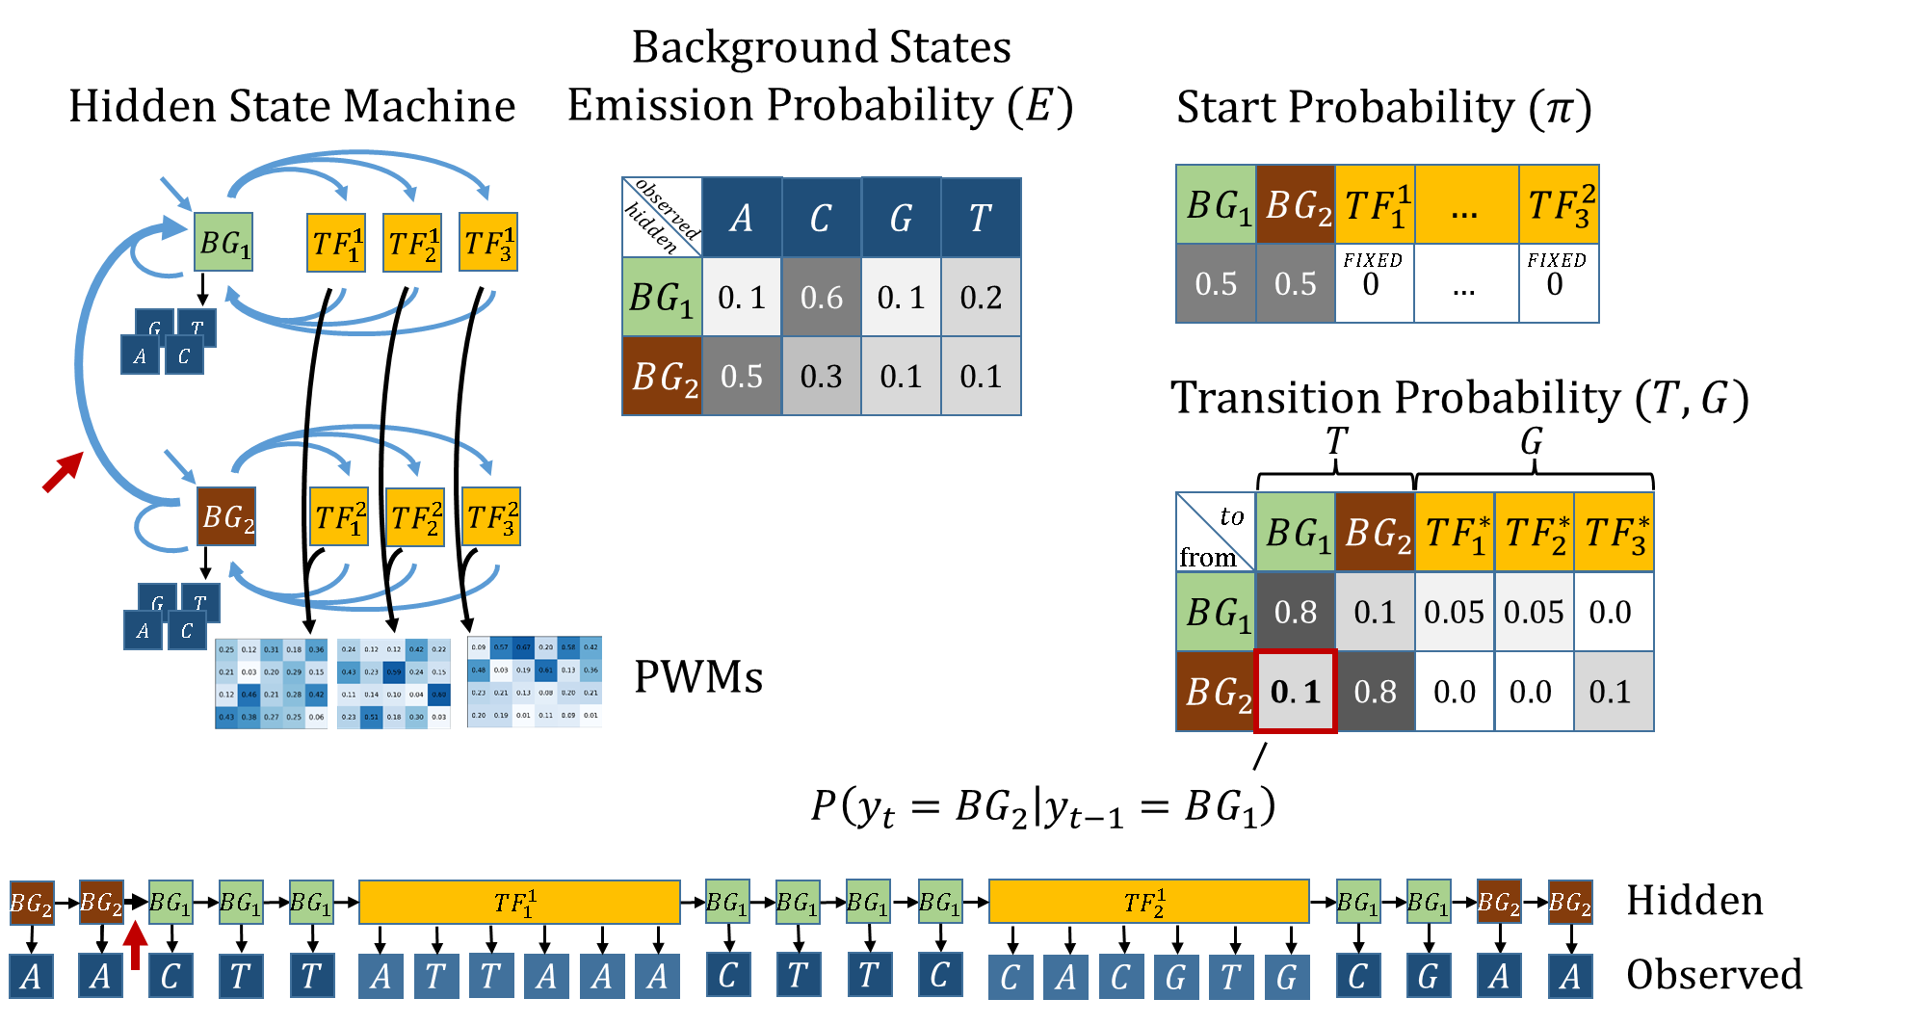

Slide 47
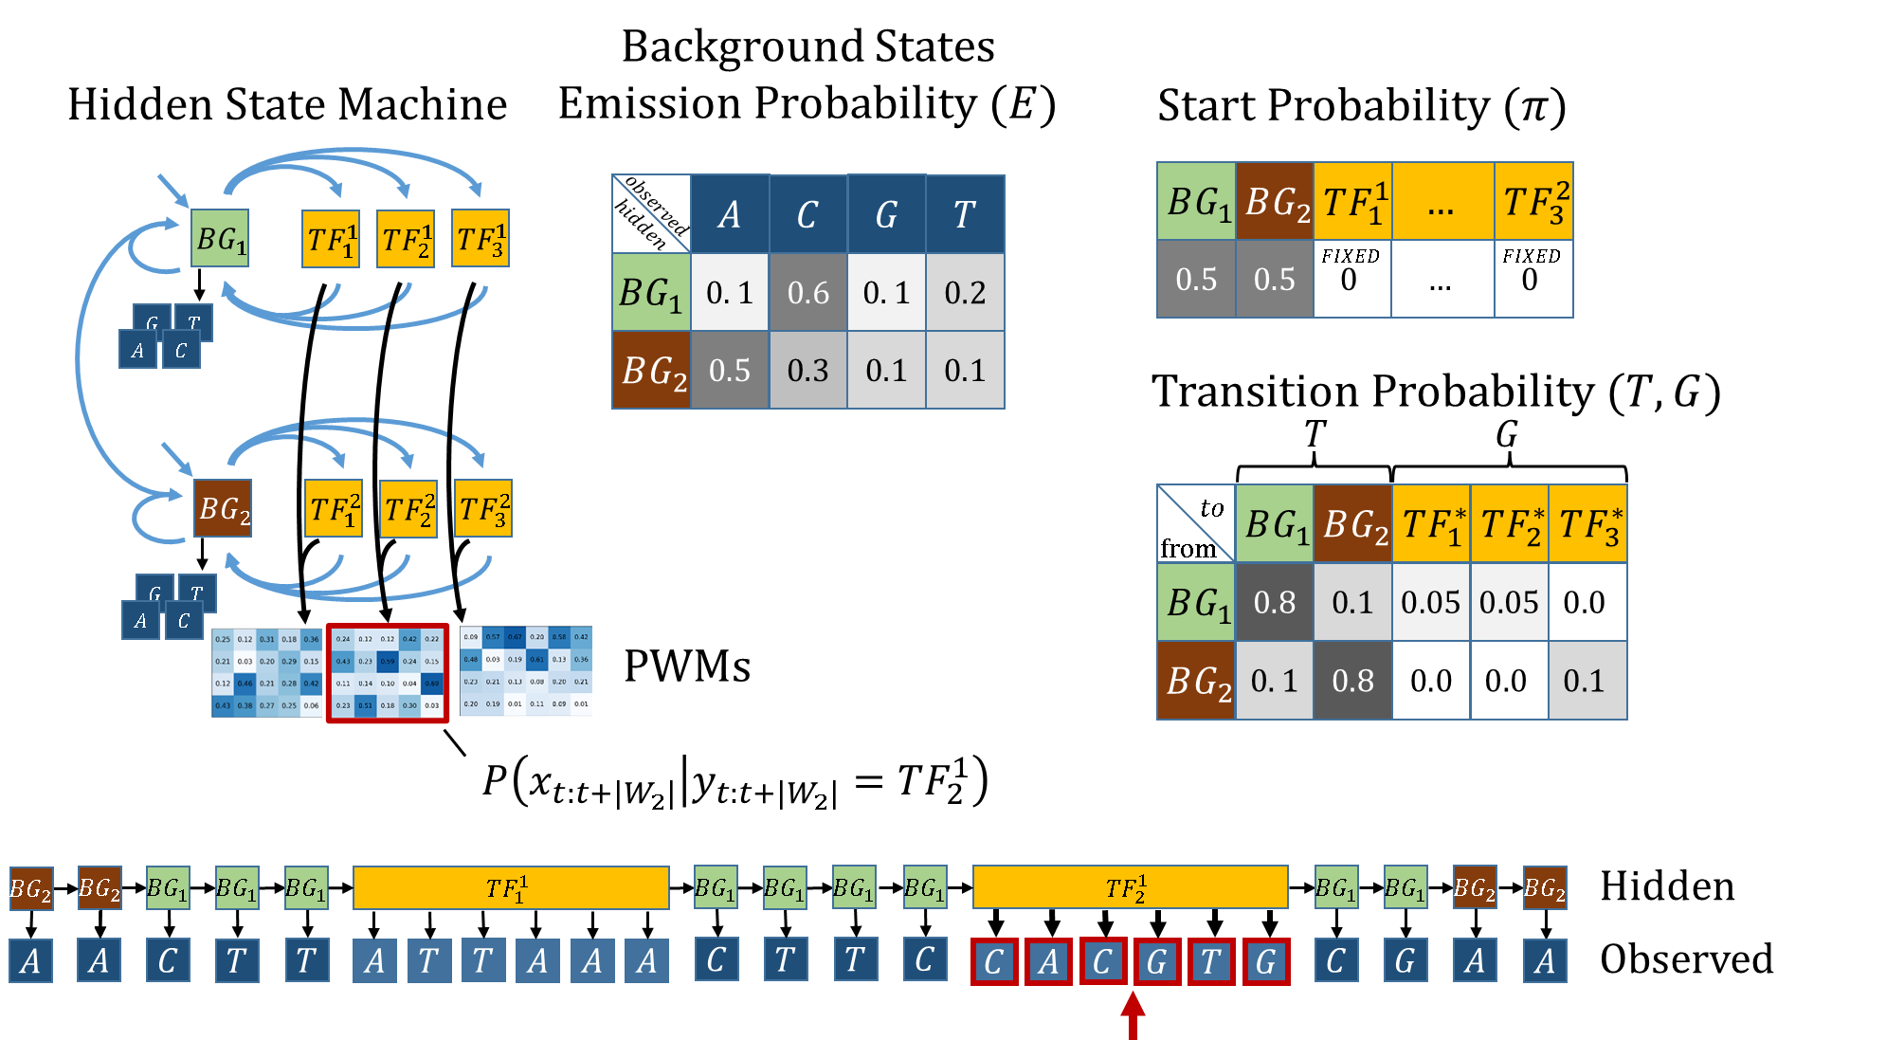

Slide 48


Slide 49
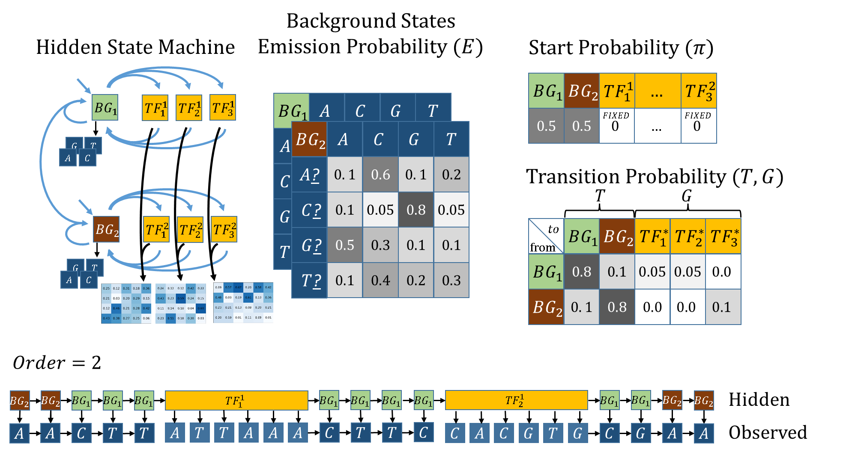

Slide 50
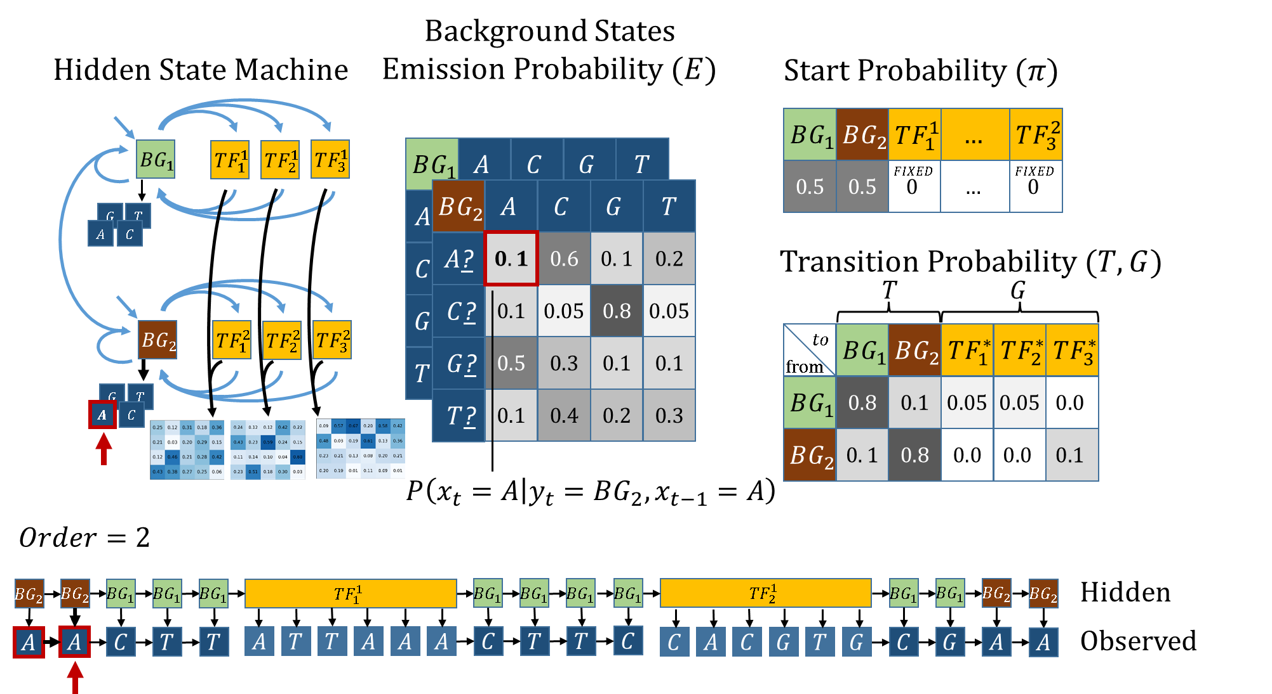

Slide 51
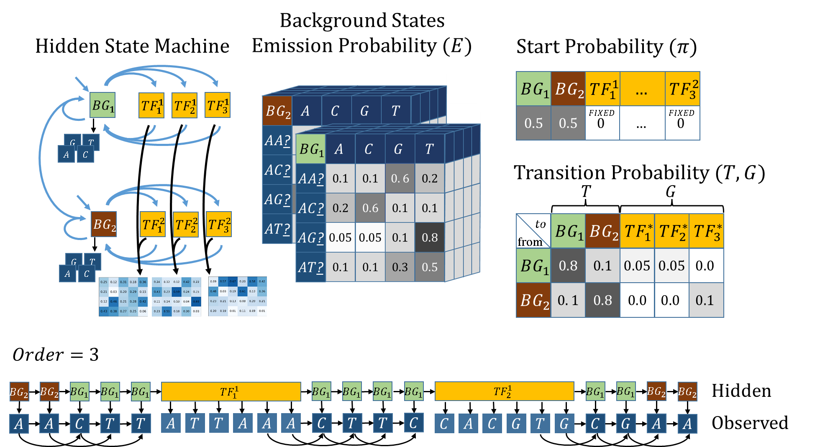

Slide 52
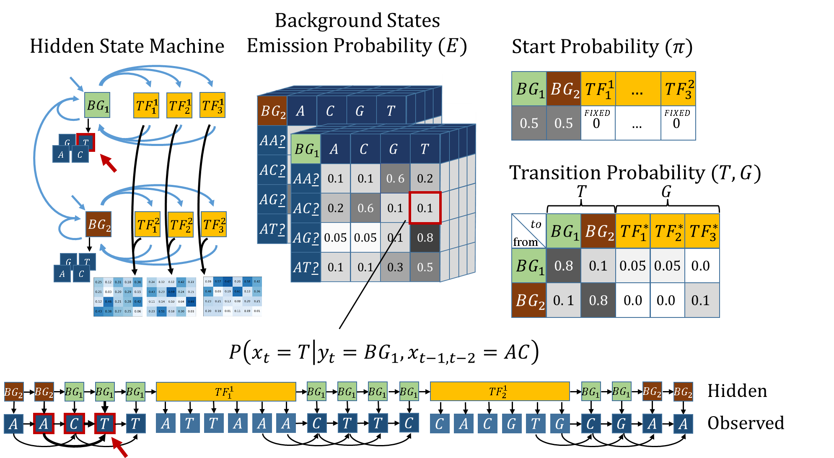

Slide 53
Outlines
Research Goal
Gene Regulation
TFBS & PWMs
HMM
HOP-HMM
Baum-Welch
Evaluation
Human DNA

Slide 54
Posterior Probability

Slide 55
Posterior Probability
What is it?
Calculation
HOP-HMM Adaptations

Slide 56
Posterior Probability- What is it?

Slide 57
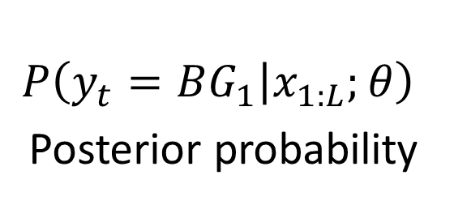
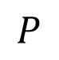
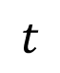
Posterior Probability- What is it?
$$P$$
$$P\left(y_{t}=BG_{1} | x_{1:L};θ\right)$$
Posterior probability
$$t$$

Slide 58
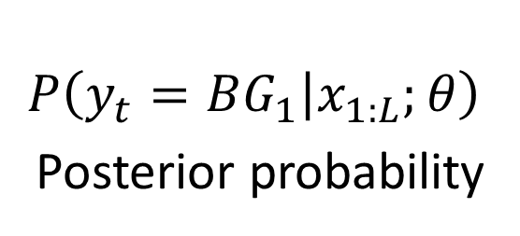
Posterior Probability- What is it?
$$P$$
$$P\left(y_{t}=BG_{1} | x_{1:L};θ\right)$$
Posterior probability
$$t$$

Slide 59
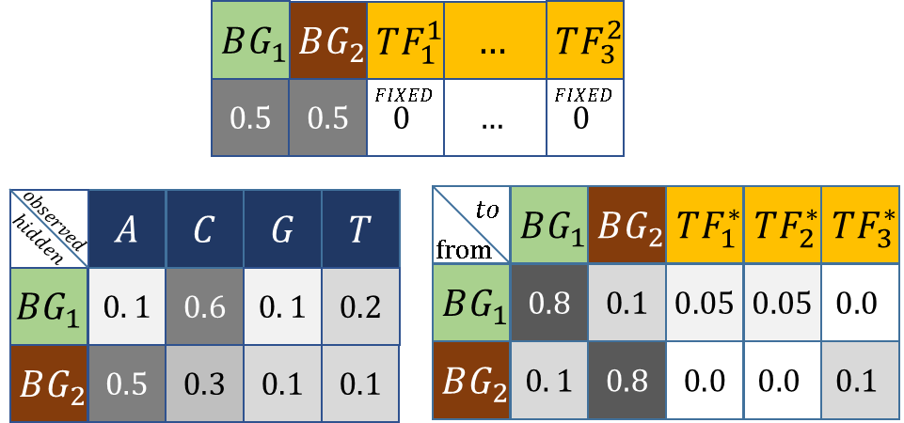


Posterior Probability- What is it?
Given:
$$P$$
Parameters $θ$
$$P\left(y_{t}=BG_{1} | x_{1:L};θ\right)$$
Posterior probability
$$t$$

Slide 60
Posterior Probability
$$P\left(y_{t}=BG_{1} | x_{1:L};θ\right)$$
Posterior probability

Slide 61

Posterior Probability - Calculation
$$P\left(y_{t} | x_{1:L}\right)$$

Slide 62

Posterior Probability - Calculation
$$P\left(y_{t} | x_{1:L}\right)=\frac{P\left(y_{t},x_{1:t}\right)⋅P\left({x_{t+1:L}|y}_{t},x_{1:t}\right) }{P\left(x_{1:t}\right) }$$

Slide 63



Posterior Probability - Calculation
$$P\left(y_{t} | x_{1:L}\right)=\frac{P\left(y_{t},x_{1:t}\right)⋅P\left({x_{t+1:L}|y}_{t},x_{1:t}\right) }{P\left(x_{1:t}\right) }$$
$α_{j,t}: P\left(y_{t}=j,x_{1:t}\right)$ Forward Probability

Slide 64

Posterior Probability - Calculation
$$P\left(y_{t} | x_{1:L}\right)=\frac{P\left(y_{t},x_{1:t}\right)⋅P\left({x_{t+1:L}|y}_{t},x_{1:t}\right) }{P\left(x_{1:t}\right) }$$
$α_{j,t}: P\left(y_{t}=j,x_{1:t}\right)$ Forward Probability
$$α_{j,t}=E_{{\text{j}\text{,}\text{x}}_{t}}⋅\sum_{\text{j}\text{′}∈\text{[}\text{m}\text{]}}{T_{\text{j}\text{′}\text{,}\text{j}}⋅α_{\text{j}\text{′}\text{,}\text{t}\text{−}\text{1}}}$$

Slide 65



Posterior Probability - Calculation
$$P\left(y_{t} | x_{1:L}\right)=\frac{P\left(y_{t},x_{1:t}\right)⋅P\left({x_{t+1:L}|y}_{t},x_{1:t}\right) }{P\left(x_{1:t}\right) }$$
$$β_{j,t}:P\left({x_{t+1:L}|y}_{t}\right)$$
Backward Probability

Slide 66

Posterior Probability - Calculation
$$P\left(y_{t} | x_{1:L}\right)=\frac{P\left(y_{t},x_{1:t}\right)⋅P\left({x_{t+1:L}|y}_{t},x_{1:t}\right) }{P\left(x_{1:t}\right) }$$
$$β_{j,t}:P\left({x_{t+1:L}|y}_{t}\right)$$
Backward Probability
$$β_{j,t}=\sum_{\text{j}\text{′}∈\text{[}\text{m}\text{]}}{β_{\text{j}\text{′}\text{,}\text{t}\text{+}\text{1}}⋅E_{{\text{j}\text{′}\text{,}\text{x}}_{t+1}}⋅T_{\text{j}\text{,}\text{j}\text{′}}}$$

Slide 67








Posterior Probability
$$BG_{1}$$
$$BG_{1}$$
$$BG_{1}$$
$$BG_{1}$$
$$BG_{1}$$
$$BG_{1}$$
$$C$$
$$T$$
$$A$$
$$C$$
$$T$$
$$T$$
$$P\left(y_{t} | x_{1:L}\right)=\frac{P\left(y_{t},x_{1:t}\right)⋅P\left({x_{t+1:L}|y}_{t},x_{1:t}\right) }{P\left(x_{1:t}\right) }$$
$$β_{j,t}:P\left({x_{t+1:L}|y}_{t}\right)$$
Backward Probability
$$β_{j,t}=\sum_{\text{j}\text{′}∈\text{[}\text{m}\text{]}}{β_{\text{j}\text{′}\text{,}\text{t}\text{+}\text{1}}⋅E_{{\text{j}\text{′}\text{,}\text{x}}_{t+1}}⋅T_{\text{j}\text{,}\text{j}\text{′}}}$$

Slide 68

Posterior Probability (HOP-HMM)
$$BG_{1}$$
$$BG_{1}$$
$$BG_{1}$$
$$BG_{1}$$
$$BG_{1}$$
$$BG_{1}$$
$$C$$
$$T$$
$$A$$
$$C$$
$$T$$
$$T$$
$$P\left(y_{t} | x_{1:L}\right)=\frac{P\left(y_{t},x_{1:t}\right)⋅P\left({x_{t+1:L}|y}_{t},x_{1:t}\right) }{P\left(x_{1:t}\right) }$$
$$β_{j,t}:P\left({x_{t+1:L}|y}_{t},x_{1:t}\right)$$
Backward Probability
$$β_{j,t}=\sum_{\text{j}\text{′}∈\text{[}\text{m}\text{]}}{β_{\text{j}\text{′}\text{,}\text{t}\text{+}\text{1}}⋅E_{{\text{j}\text{′}\text{,}\text{x}}_{t+1}}⋅T_{\text{j}\text{,}\text{j}\text{′}}}$$

Slide 69


















Forward Algorithm
$$t\text{−}|W_{1}|\text{−}1$$
$$t\text{−}|W_{2}|\text{−}1$$
$$t$$
$$t\text{−}1$$
$$t$$
$$α_{j,t}$$
$$j$$
$$α_{j,t}$$
$$j$$
Backward Algorithm
$$t$$
$$t\text{−}|W_{2}|\text{−}1$$
$$t\text{−}|W_{1}|\text{−}1$$
$$t$$
$$t\text{+}1$$
$$β_{j,t}$$
$$j$$
$$β_{j,t}$$
$$j$$

Slide 70

































EM (Baum-Welch)
$$x_{1:L}$$
$$C$$
$$A$$
$$C$$
$$G$$
$$T$$
$$G$$
$$T$$
$$T$$
$$A$$
$$G$$
$$A$$
$$T$$
$$T$$
$$A$$
$$A$$
$$G$$
$$C$$
$$A$$
$$C$$
$$G$$
$$T$$
$$G$$
$$T$$
$$A$$
$$A$$
$$G$$
$$C$$
$$A$$
$$C$$
$$G$$
$$T$$
$$G$$
E-step
M-step
$$P$$
$$P\left(y_{t}=BG_{1} | x_{1:L};θ\right)$$
Posterior probability
$$t$$
Parameters $θ$

Slide 71
EM (Baum-Welch)
$$x_{1:L}$$
$$C$$
$$A$$
$$C$$
$$G$$
$$T$$
$$G$$
$$T$$
$$T$$
$$A$$
$$G$$
$$A$$
$$T$$
$$T$$
$$A$$
$$A$$
$$G$$
$$C$$
$$A$$
$$C$$
$$G$$
$$T$$
$$G$$
$$T$$
$$A$$
$$A$$
$$G$$
$$C$$
$$A$$
$$C$$
$$G$$
$$T$$
$$G$$
E-step
M-step
$$P$$
$$P\left(y_{t}=BG_{1} | x_{1:L};θ\right)$$
Posterior probability
$$t$$
Parameters $θ$

Slide 72
Outlines
Research Goal
Gene Regulation
TFBS & PWMs
HMM
HOP-HMM
Baum-Welch
Evaluation
Human DNA

Slide 73


Slide 74

EM Regularization

Slide 75


Slide 76

Avg precision: 0.97
Avg recall: 0.98

Slide 77
Outlines
Research Goal
Gene Regulation
TFBS & PWMs
HMM
HOP-HMM
Baum-Welch
Evaluation
Human DNA

Slide 78


Slide 79

Umbilical Vein Endothelial (E122) vs Monocyte (E124)
H3K27ac
Umbilical Vein
Endothelial
DNase-I
ChromHMM
HOP-HMM
Prediction
Posterior
Probability
Viterbi Path
H3K27ac
Monocyte
DNase-I
ChromHMM
hg19:chr1

Slide 80
Umbilical Vein Endothelial (E122) vs Monocyte (E124)
H3K27ac
Umbilical Vein
Endothelial
DNase-I
ChromHMM
HOP-HMM
Prediction
Posterior
Probability
FOXQ1
FOXD3
FOXD3
Viterbi Path
FOXP1
DIX1
FOXP1
H3K27ac
Monocyte
DNase-I
ChromHMM
hg19:chr1
Notes:
FOX proteins - embryonic development

Slide 81


Gastric (E094) vs Mesendoderm (E004)
H3K27ac
Gastric
DNase-I
ChromHMM
HOP-HMM
Prediction
Posterior
Probability
GSC2
HLTF
HLTF
SRY
Viterbi Path
H3K27ac
Mesendoderm
DNase-I
ChromHMM
hg19:chr5
Notes:
SRY – sex determining
Mesendoderm – first stage cells in embryo

Slide 82
Mesendoderm (E004) vs Ovary (E097)
H3K27ac
Mesendoderm
DNase-I
ChromHMM
HOP-HMM
Prediction
Posterior
Probability
POU5F1B
NFATC2
Viterbi Path
H3K27ac
Ovary
DNase-I
ChromHMM
hg19:chr11

Slide 83
Extras

Slide 84

Code in GitHub
https://github.com/David-Taub/HOP-HMM

Slide 85



Slide 86


Slide 87


Slide 88


Slide 89


